Slide 1
Annulus Volume of Revolution

Slide 2
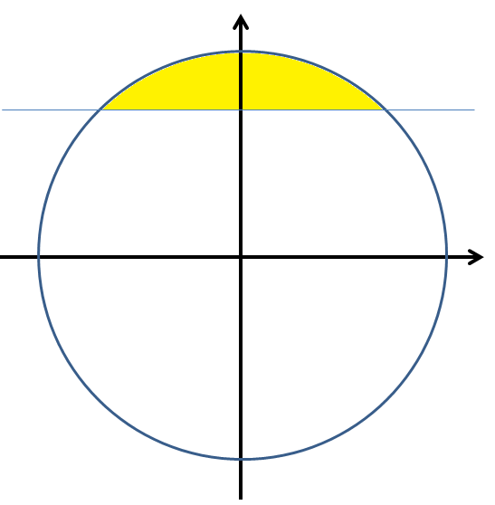
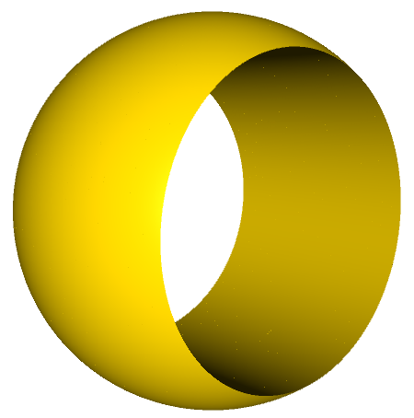
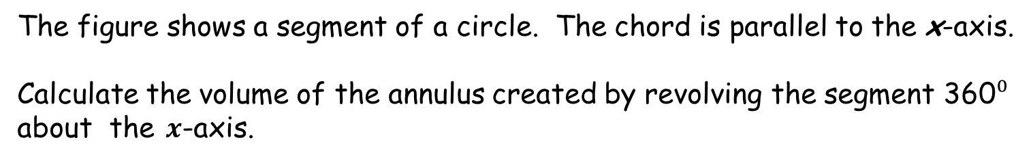




Annulus Volume of Revolution
$$y$$
NOT to scale.
$$13 mm$$
$$x$$
$$24 mm$$
The figure shows a segment of a circle. The chord is parallel to the x-axis.
Calculate the volume of the annulus created by revolving the segment 360⁰ about the $x$-axis.

Slide 3
R (mm) | h (mm)
13 | 5
20 | 16
25.5 | 22.5
37 | 35
72.5 | 71.5
17.4 | 12.6
40.9 | 39.1
13.6 | 6.4
16.9 | 11.9
15 | 9
21.8 | 18.2
24.1 | 20.9
Hint:

Slide 4



Annulus Volume of Revolution
$$y$$
NOT to scale.
$$h$$
The general case:
$$R$$
$$x$$
$$2w$$
The figure shows a segment of a circle. The chord is parallel to the x-axis.
Calculate the volume of the annulus created by revolving the segment 360⁰ about the $x$-axis.

Slide 5




Annulus Volume of Revolution
$$y$$
$$dx$$
$$R$$
Solution
$$h$$
$$w$$
$$x$$
To solve for the general case refer to the diagram above:

Slide 6
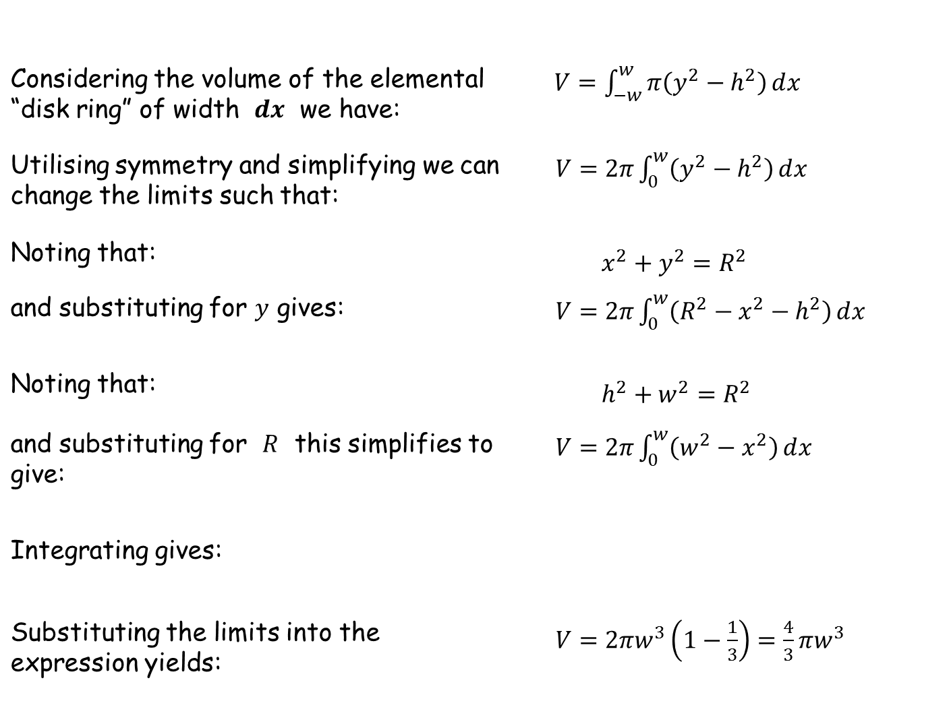
Solution
Considering the volume of the elemental “disk ring” of width $ⅆx$ we have: | $V=\int_{−w}^{w}{π\left(y^{2}−h^{2}\right)ⅆx}$
Utilising symmetry and simplifying we can change the limits such that: | $V=2π\int_{0}^{w}{\left(y^{2}−h^{2}\right)ⅆx}$
Noting that: | $x^{2}+y^{2}=R^{2}$
and substituting for $y$ gives: | $V=2π\int_{0}^{w}{\left(R^{2}−x^{2}−h^{2}\right)}ⅆx$
Noting that: | $h^{2}+w^{2}=R^{2}$
and substituting for $R$ this simplifies to give: | $V=2π\int_{0}^{w}{\left(w^{2}−x^{2}\right)}ⅆx$
Integrating gives:
Substituting the limits into the expression yields: | $V=2πw^{3}\left(1−\frac{1}{3}\right)=\frac{4}{3}πw^{3}$

Slide 7
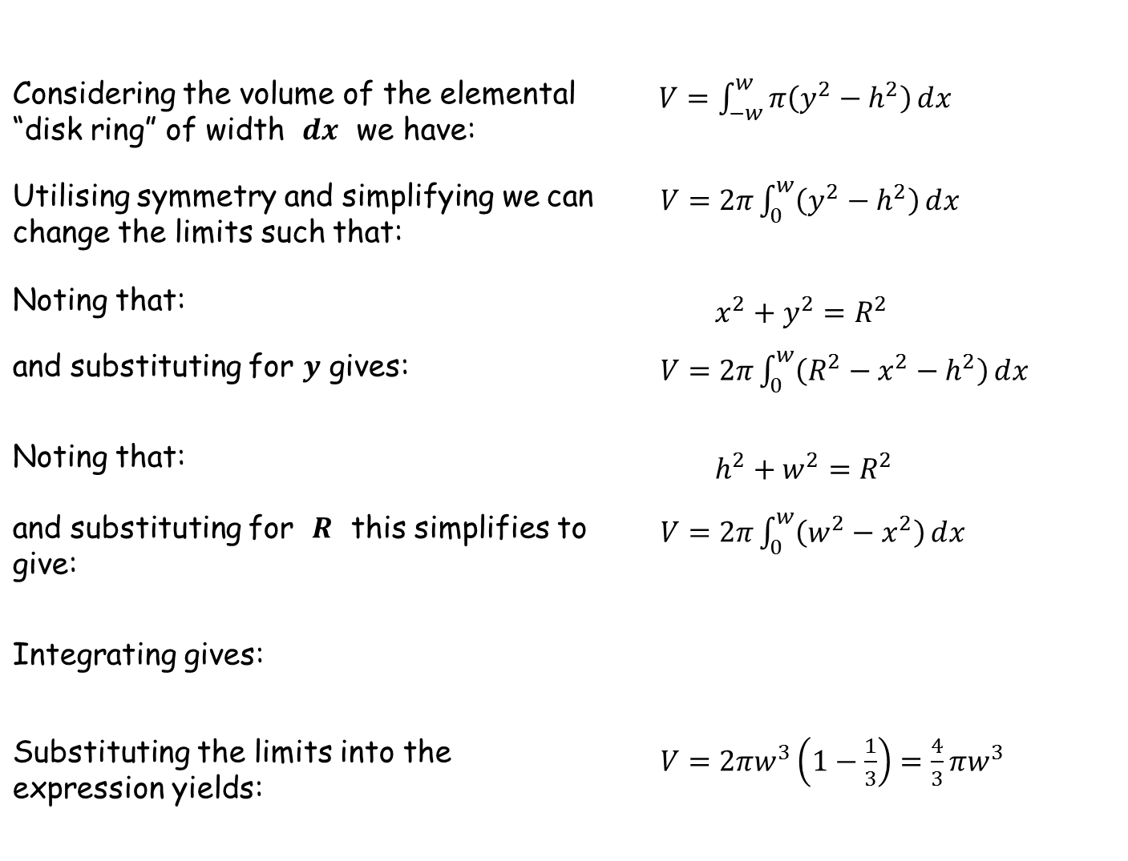
Solution
Considering the volume of the elemental “disk ring” of width $ⅆx$ we have: | $V=\int_{−w}^{w}{π\left(y^{2}−h^{2}\right)ⅆx}$
Utilising symmetry and simplifying we can change the limits such that: | $V=2π\int_{0}^{w}{\left(y^{2}−h^{2}\right)ⅆx}$
Noting that: | $x^{2}+y^{2}=R^{2}$
and substituting for $y$ gives: | $V=2π\int_{0}^{w}{\left(R^{2}−x^{2}−h^{2}\right)}ⅆx$
Noting that: | $h^{2}+w^{2}=R^{2}$
and substituting for $R$ this simplifies to give: | $V=2π\int_{0}^{w}{\left(w^{2}−x^{2}\right)}ⅆx$
Integrating gives:
Substituting the limits into the expression yields: | $V=2πw^{3}\left(1−\frac{1}{3}\right)=\frac{4}{3}πw^{3}$

Slide 8
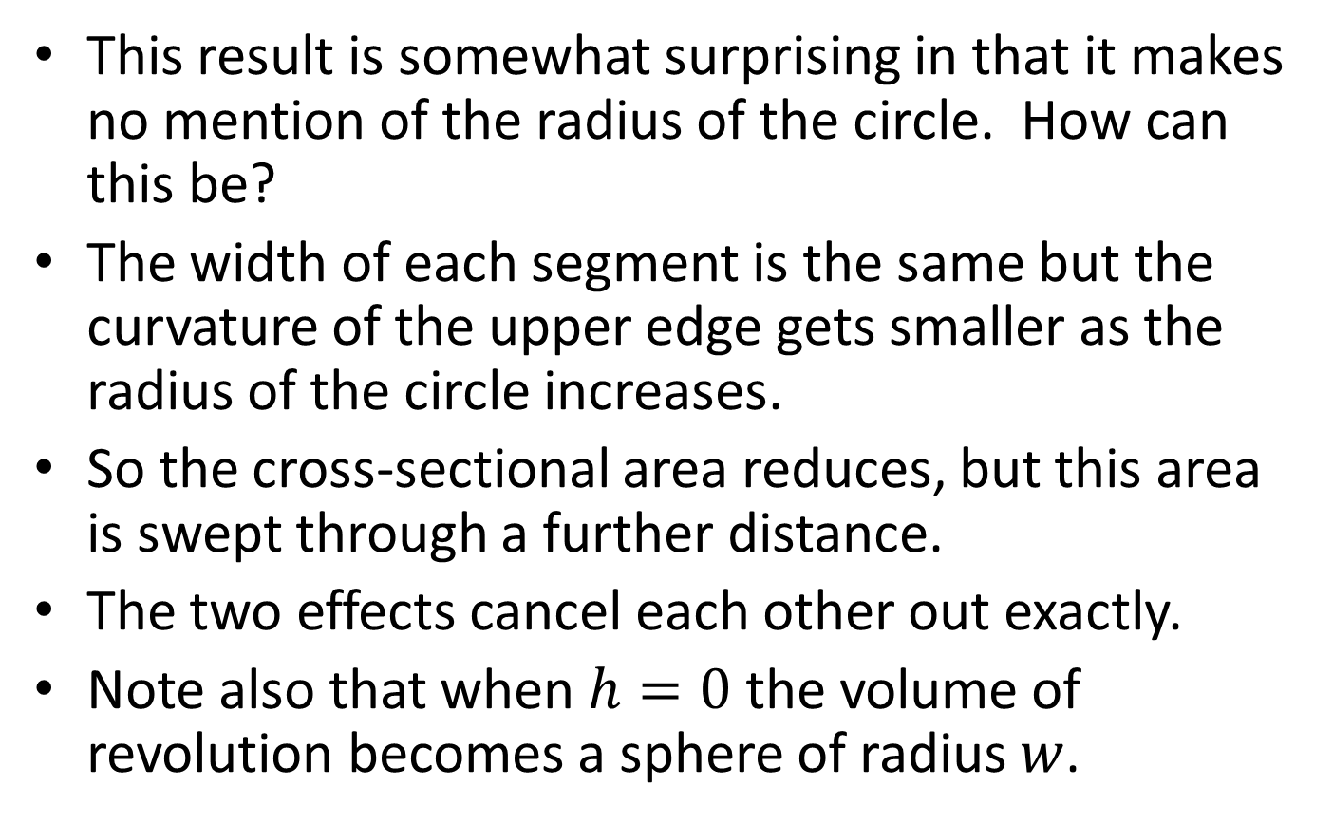

$$V=\frac{4}{3}πw^{3}$$
This result is somewhat surprising in that it makes no mention of the radius of the circle. How can this be?
The width of each segment is the same but the curvature of the upper edge gets smaller as the radius of the circle increases.
So the cross-sectional area reduces, but this area is swept through a further distance.
The two effects cancel each other out exactly.
Note also that when $h=0$ the volume of revolution becomes a sphere of radius $w$.

Slide 9
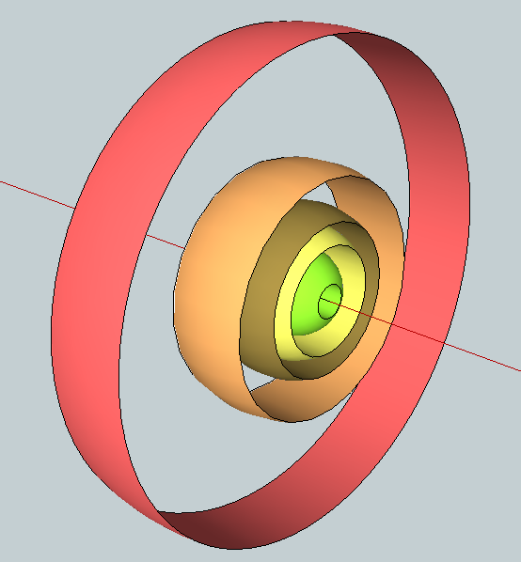
Here’s how some of the annuli look in 3D

Slide 10
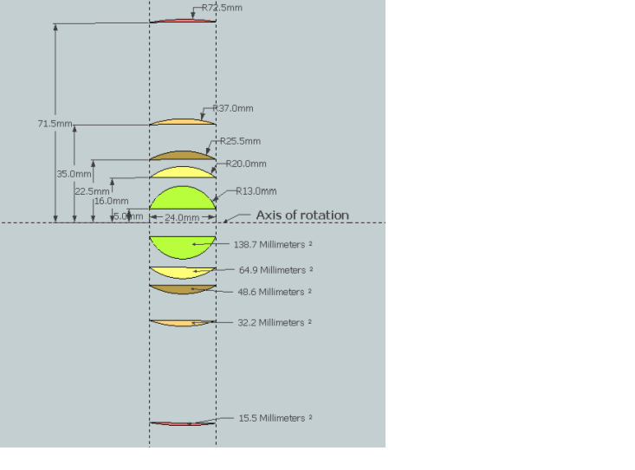
And in cross-section

Slide 11
Extension
Locate the centre of area of the segment
The volume of a solid with a regular cross section can be found by multiplying the area of the cross section by the length of the path taken by its centre of area (Pappus). Since we can calculate the area of cross section and the volume of the solid we can easily determine the distance to the centre of area from the axis of rotation.

Slide 13
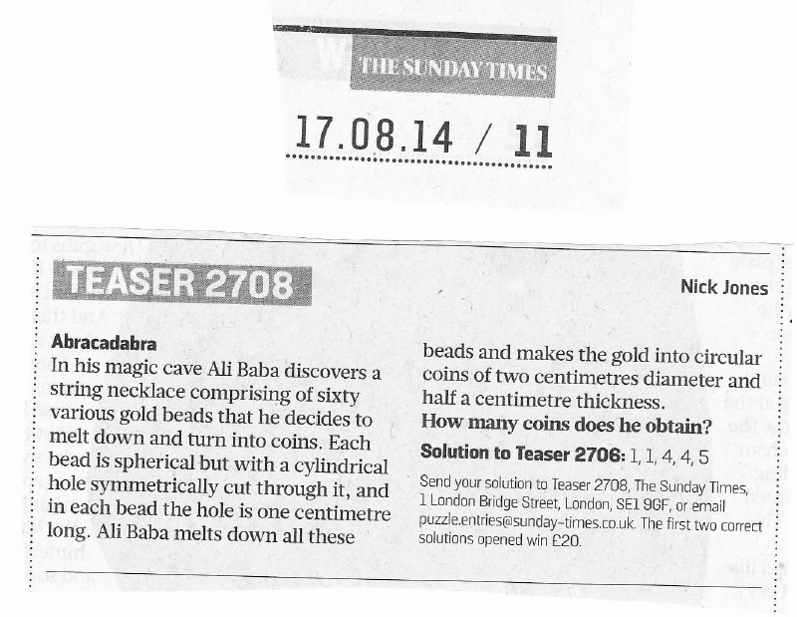
Sunday Times Teaser
This puzzle appeared in the Sunday Times:

Slide 14
RESOURCES
Use the spreadsheet to plot answers as they come in (for fun!).

Slide 15

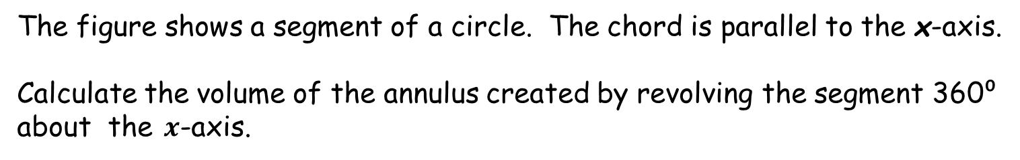



Annulus Volume of Revolution
$$y$$
NOT to scale.
$$13 mm$$
$$x$$
$$24 mm$$
The figure shows a segment of a circle. The chord is parallel to the x-axis.
Calculate the volume of the annulus created by revolving the segment 360⁰ about the $x$-axis.
SIC_6

Slide 16

Annulus Volume of Revolution
$$y$$
NOT to scale.
$$20 mm$$
$$x$$
$$24 mm$$
The figure shows a segment of a circle. The chord is parallel to the x-axis.
Calculate the volume of the annulus created by revolving the segment 360⁰ about the $x$-axis.
SIC_6

Slide 17

Annulus Volume of Revolution
$$y$$
NOT to scale.
$$25.5 mm$$
$$x$$
$$24 mm$$
The figure shows a segment of a circle. The chord is parallel to the x-axis.
Calculate the volume of the annulus created by revolving the segment 360⁰ about the $x$-axis.
SIC_6

Slide 18

Annulus Volume of Revolution
$$y$$
NOT to scale.
$$37 mm$$
$$x$$
$$24 mm$$
The figure shows a segment of a circle. The chord is parallel to the x-axis.
Calculate the volume of the annulus created by revolving the segment 360⁰ about the $x$-axis.
SIC_6

Slide 19

Annulus Volume of Revolution
$$y$$
NOT to scale.
$$72.5 mm$$
$$x$$
$$24 mm$$
The figure shows a segment of a circle. The chord is parallel to the x-axis.
Calculate the volume of the annulus created by revolving the segment 360⁰ about the $x$-axis.
SIC_6

Slide 20

Annulus Volume of Revolution
$$y$$
NOT to scale.
$$17.4 mm$$
$$x$$
$$24 mm$$
The figure shows a segment of a circle. The chord is parallel to the x-axis.
Calculate the volume of the annulus created by revolving the segment 360⁰ about the $x$-axis.
SIC_6

Slide 21

Annulus Volume of Revolution
$$y$$
NOT to scale.
$$40.9 mm$$
$$x$$
$$24 mm$$
The figure shows a segment of a circle. The chord is parallel to the x-axis.
Calculate the volume of the annulus created by revolving the segment 360⁰ about the $x$-axis.
SIC_6

Slide 22

Annulus Volume of Revolution
$$y$$
NOT to scale.
$$13.6 mm$$
$$x$$
$$24 mm$$
The figure shows a segment of a circle. The chord is parallel to the x-axis.
Calculate the volume of the annulus created by revolving the segment 360⁰ about the $x$-axis.
SIC_6

Slide 23

Annulus Volume of Revolution
$$y$$
NOT to scale.
$$16.9 mm$$
$$x$$
$$24 mm$$
The figure shows a segment of a circle. The chord is parallel to the x-axis.
Calculate the volume of the annulus created by revolving the segment 360⁰ about the $x$-axis.
SIC_6

Slide 24

Annulus Volume of Revolution
$$y$$
NOT to scale.
$$15 mm$$
$$x$$
$$24 mm$$
The figure shows a segment of a circle. The chord is parallel to the x-axis.
Calculate the volume of the annulus created by revolving the segment 360⁰ about the $x$-axis.
SIC_6

Slide 25

Annulus Volume of Revolution
$$y$$
NOT to scale.
$$21.8 mm$$
$$x$$
$$24 mm$$
The figure shows a segment of a circle. The chord is parallel to the x-axis.
Calculate the volume of the annulus created by revolving the segment 360⁰ about the $x$-axis.
SIC_6

Slide 26

Annulus Volume of Revolution
$$y$$
NOT to scale.
$$24.1 mm$$
$$x$$
$$24 mm$$
The figure shows a segment of a circle. The chord is parallel to the x-axis.
Calculate the volume of the annulus created by revolving the segment 360⁰ about the $x$-axis.
SIC_6

